Slide 1
LAB Ⅱ LECTURE 06
Modern STL
Seoul National University
Graphics & Media Lab
Notes:
저도 조교하면서 실습을 먼저 강의하는 것은 처음. 슬퍼하지 마시고 너무..

Slide 2
Contents
STL in modern C++
Sequence container
tuple
chrono

Slide 3
Sequence Container
Storage of data elements
Elements can be accessed sequentially
C++ standard (namespace std)
array
vector
deque
list
forward_list

Slide 4
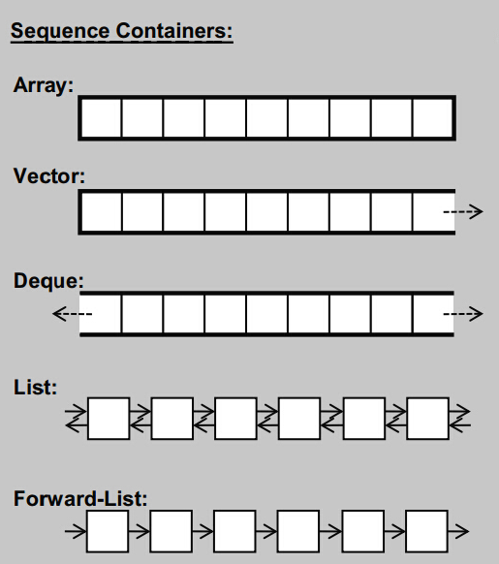
Sequence Container

Slide 5
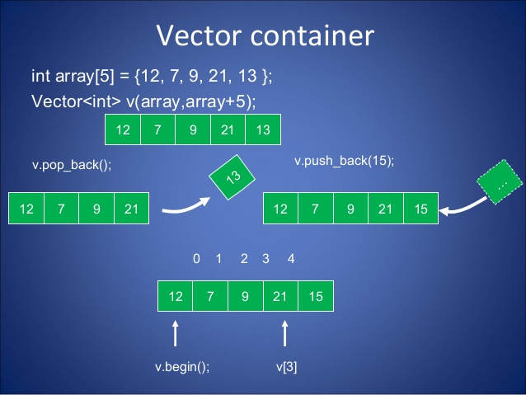
Vector
template<class T> class vector;
The memory occupied by the vector is managed automatically, being expanded and contracted as needed.
Insertion or removal is allowed only at the end.
push_back(), pop_back()

Slide 6
Practice
#include <iostream>
#include <vector>
void main ()
{
std::vector<int> myvector;
int sum (0);
myvector.push_back (100);
myvector.push_back (200);
myvector.push_back (300);
while (!myvector.empty())
{
sum+=myvector.back();
myvector.pop_back();
}
std::cout << "The elements of myvector add up to " << sum << '\n';
}

Slide 7
std::array
Since C++11
template<class T, std::size_t N> struct array;
Fixed size array
Include <vector> header

Slide 8
Member function
array::array | 배열 개체를 생성합니다.
array::assign | 모든 요소를 바꿉니다.
array::at | 지정된 위치에 있는 요소에 액세스합니다.
array::back | 마지막 요소에 액세스합니다.
array::begin | 제어되는 시퀀스의 시작을 지정합니다.
array::cbegin | 배열의 첫 번째 요소에 대한 임의 액세스 const 반복기를 반환합니다.
array::cend | 배열 끝의 바로 다음을 가리키는 임의 액세스 const 반복기를 반환합니다.
array::crbegin | 역방향 배열의 첫 번째 요소에 대해 const 반복기를 반환합니다.
array::crend | 역방향 배열 끝에 대해 const 반복기를 반환합니다.
array::data | 첫 번째 요소의 주소를 가져옵니다.
array::empty | 요소가 있는지 테스트합니다.
array::end | 제어되는 시퀀스의 씉을 지정합니다.
array::fill | 지정된 값을 가진 모든 요소를 바꿉니다.
array::front | 첫번째 요소에 액세스합니다.
array::max_size | 요소 수를 계산합니다.
array::rbegin | 제어되는 역방향 시퀀스의 시작을 지정합니다.
array::rend | 제어되는 역방향 시퀀스의 끝을 지정합니다.
array::size | 요소 수를 계산합니다.
array::swap | 두 컨테이너의 내용을 바꿉니다.

Slide 9
Practice
#include <string>
#include <iostream>
#include <algorithm>
#include <array>
using namespace std;
void main()
{
array<int, 5> i_array1 = {3, 4, 5, 1, 2};
array<int, 5> i_array2 = {1, 2, 3, 4, 5};
array<string, 2> string_array = {string("a"), "b"};
cout << "string_array : ";
for(auto& s: string_array)
cout << s << ' ';
string_array[0] = "C++";
string_array[1] = "STL";
cout << "\nmodified string_array : ";
for(auto& s: string_array)
cout << s << ' ';
cout << "\ninitial i_array1 : ";
for(auto i: i_array1)
cout << i << ' ';
sort(i_array1.begin(), i_array1.end());
cout << "\nsored i_array1 : ";
for(auto i: i_array1)
cout << i << ' ';
cout << "\nInitial i_array2 : ";
for(auto i: i_array2)
cout << i << ' ';
reverse(i_array2.begin(), i_array2.end());
cout << "\nreversed i_array2 : ";
for(auto i: i_array2)
cout << i << ' ';
cout << endl;
}

Slide 10
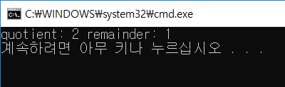
Function may need to return multiple values
Function can return only one variable
Do we need to return 2 variables?
Ex) Function to return quotient and remainder from two integers
Practice: implement the division function
Freely change the return type and parameter
int add(int x, int y){
return x+y;
}
int division(int x, int y){
//return quotient and remainder
}
void main(){
int quotient, remainder;
division(7,3);
cout << "quotient: " << quotient
<< " remainder: " << remainder << endl;
}

Slide 11
Returning multi values without using tuple
vector<int> division(int x, int y){
vector<int> a;
a.push_back(x/y);
a.push_back(x-a[0]*y);
return a;
}
Use array
Use vector STL
Same type of return variables
Use reference
Too many parameters
Use class or struct
Unnecessary class
Too complicated program
So, use tuple STL
void division(int x, int y, int& quotient, int& remainder){
quotient = x/y;
remainder = x-quotient*y;
}
class Divide
{
public:
Divide(){}
Divide(int q, int r){quotient = q; remainder = r;}
~Divide(){}
int quotient, remainder;
};
Divide division(int x, int y){
return Divide(x/y, x-x/y*y);
}

Slide 12
tuple
Any number of values can be returned by packing them into a tuple.
#include <iostream>
#include <tuple>
std::tuple<int, int> division(int x, int y){
return std::tuple<int, int>(x/y, x-x/y*y);
}
void main(){
int quotient, remainder;
auto result = division(7,3);
quotient = std::get<0>(result);
remainder = std::get<1>(result);
std::cout << "quotient: " << quotient
<< " remainder: " << remainder << std::endl;
}

Slide 13

tuple
Any number of values can be returned by packing them into a tuple.
#include <iostream>
#include <tuple>
#include <string>
std::tuple<int, int, std::string> division(int x, int y){
return std::tuple<int, int, std::string> (x/y, x-x/y*y,"Success");
}
void main(){
int quotient, remainder;
std::string code;
auto result = division(7,3);
quotient = std::get<0>(result);
remainder = std::get<1>(result);
code = std::get<2>(result);
std::cout << "code: " << code << std::endl;
std::cout << "quotient: " << quotient
<< " remainder: " << remainder << std::endl;
}

Slide 14
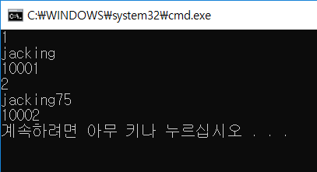
tuple
#include <tuple>
#include <iostream>
#include <string>
struct ITEM{
int nID;
};
void main(){
ITEM item;
item.nID = 10001;
std::tuple<int, std::string, ITEM> UserItem
= std::tuple<int, std::string, ITEM>(1, "jacking", item);
std::cout << std::get<0>(UserItem) << std::endl;
std::cout << std::get<1>(UserItem) << std::endl;
std::cout << std::get<2>(UserItem).nID << std::endl;
std::get<0>(UserItem) = 2;
std::get<1>(UserItem) = "jacking75";
std::get<2>(UserItem).nID = 10002;
std::cout << std::get<0>(UserItem) << std::endl;
std::cout << std::get<1>(UserItem) << std::endl;
std::cout << std::get<2>(UserItem).nID << std::endl;
}

Slide 15
tuple
Defining the tuple
std::tuple<type1, type2, …> name
std::tuple<int, std::string, ITEM> UserItem
Accessing the tuple
std::get<position>(name)
std::cout << std::get<0>(UserItem) << std::endl;
std::get<1>(UserItem) = "jacking75";

Slide 16
Simpler Way of Defining a tuple
Use std::make_tuple function
#include <tuple>
#include <iostream>
#include <string>
struct ITEM{
int nID;
};
void main(){
ITEM item;
item.nID = 10001;
std::tuple<int, std::string, ITEM> UserItem
= std::make_tuple(1, "jacking", item);
std::cout << std::get<0>(UserItem) << std::endl;
std::cout << std::get<1>(UserItem) << std::endl;
std::cout << std::get<2>(UserItem).nID << std::endl;
}

Slide 17
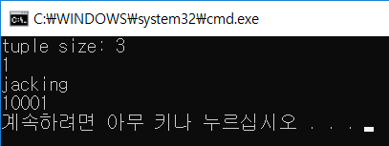
tuple Size
Use std::tuple_size<tuple type>::value
std::tuple_size<std::tuple<int, std::string, ITEM>>::value
std::tuple_size<decltype(UserItem)>::value
#include <tuple>
#include <iostream>
#include <string>
struct ITEM{
int nID;
};
void main(){
ITEM item;
item.nID = 10001;
std::tuple<int, std::string, ITEM> UserItem
= std::make_tuple(1, "jacking", item);
auto count = std::tuple_size<std::tuple<int, std::string, ITEM>>::value;
std::cout << "tuple size: " << count << std::endl;
std::cout << std::get<0>(UserItem) << std::endl;
std::cout << std::get<1>(UserItem) << std::endl;
std::cout << std::get<2>(UserItem).nID << std::endl;
}

Slide 18
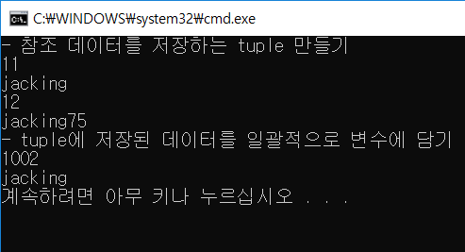
Handling tuple with std::tie
#include <tuple>
#include <iostream>
#include <string>
void main(){
std::cout << "- 참조 데이터를 저장하는 tuple 만들기" << std::endl;
int nUserIndex = 11;
std::string UserName = "jacking";
auto refUserItem = std::tie(nUserIndex, UserName);
std::cout << std::get<0>(refUserItem) << std::endl;
std::cout << std::get<1>(refUserItem) << std::endl;
std::get<0>(refUserItem) = 12;
std::get<1>(refUserItem) = "jacking75";
std::cout << nUserIndex << std::endl;
std::cout << UserName << std::endl;
std::cout << "- tuple에 저장된 데이터를 일괄적으로 변수에 담기" << std::endl;
std::tuple<int, std::string> UserInfo(1002, "jacking");
std::tie(nUserIndex, UserName) = UserInfo;
std::cout << nUserIndex << std::endl;
std::cout << UserName << std::endl;
}

Slide 19

Concatenating Multiple tuples
Use std::tuple_cat
#include <tuple>
#include <iostream>
#include <string>
void main()
{
std::tuple<int, std::string> UserInfo(1002, "jacking");
std::tuple<int, int> GameResult(12, 3);
auto UserGaemResult = std::tuple_cat(UserInfo, GameResult);
std::cout << std::get<0>(UserGaemResult) << std::endl;
std::cout << std::get<1>(UserGaemResult) << std::endl;
std::cout << std::get<2>(UserGaemResult) << std::endl;
std::cout << std::get<3>(UserGaemResult) << std::endl;
}

Slide 20

Time Measurement
Measuring time in program
In C program, the function time() exists.
It measures the number of seconds since 00:00 hours, Jan 1, 1970 UTC
/* time example */
#include <iostream>
#include <ctime>
using namespace std;
void main ()
{
time_t timer;
struct tm* timeInfo;
time(&timer); /* get current time; same as: timer = time(NULL) */
timeInfo = localtime(&timer);
cout << timer << endl;
cout << timeInfo->tm_year+1900 <<". " << timeInfo->tm_mon+1 << ". " << timeInfo->tm_mday << endl;
cout << timeInfo->tm_hour << ":" << timeInfo->tm_min<< ":" << timeInfo->tm_sec << endl;
}

Slide 21

Time Measurement
The unit of time() function
in seconds
#include <iostream>
#include <ctime>
using namespace std;
void Test(){
for ( long i = 0; i < 10000000; ++i )
std::sqrt( 123.456L );
}
void main ()
{
time_t startTime, endTime;
time(&startTime);
Test();
time(&endTime);
cout << "duration: " << endTime - startTime << endl;
}

Slide 22
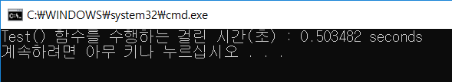
chrono
Use STL chrono!
More precise measurements are possible
#include <chrono>
#include <iostream>
#include <cmath>
void Test(){
for ( long i = 0; i < 10000000; ++i )
std::sqrt( 123.456L );
}
void main()
{
auto start = std::chrono::system_clock::now();
Test();
std::chrono::duration<double> sec
= std::chrono::system_clock::now() - start;
std::cout << "Test() 함수를 수행하는 걸린 시간(초) : "
<< sec.count() << " seconds" << std::endl;
}

Slide 23
chrono
#include <chrono>
#include <iostream>
#include <cmath>
void Test(){
for ( long i = 0; i < 10000000; ++i )
std::sqrt( 123.456L );
}
void main(){
std::chrono::system_clock::time_point StartTime = std::chrono::system_clock::now();
Test();
std::chrono::system_clock::time_point EndTime = std::chrono::system_clock::now();
std::chrono::duration<double> DefaultSec = EndTime - StartTime;
std::chrono::nanoseconds nano = EndTime - StartTime;
auto micro = std::chrono::duration_cast<std::chrono::microseconds>(EndTime - StartTime);
auto mill= std::chrono::duration_cast<std::chrono::milliseconds>(EndTime - StartTime);
auto sec= std::chrono::duration_cast<std::chrono::seconds>(EndTime - StartTime);
auto min= std::chrono::duration_cast<std::chrono::minutes>(EndTime - StartTime);
auto hour= std::chrono::duration_cast<std::chrono::hours>(EndTime - StartTime);
std::cout << "Test() 함수를 수행하는 걸린 시간 : " << DefaultSec.count() << " default" << std::endl;
std::cout << "Test() 함수를 수행하는 걸린 시간 : " << nano.count() << " nanoseconds" << std::endl;
std::cout << "Test() 함수를 수행하는 걸린 시간 : " << micro.count() << " microseconds" << std::endl;
std::cout << "Test() 함수를 수행하는 걸린 시간 : " << mill.count() << " milliseconds" << std::endl;
std::cout << "Test() 함수를 수행하는 걸린 시간 : " << sec.count() << " seconds" << std::endl;
std::cout << "Test() 함수를 수행하는 걸린 시간 : " << min.count() << " minutes" << std::endl;
std::cout << "Test() 함수를 수행하는 걸린 시간 : " << hour.count() << " hour" << std::endl;
}

